Slide 1

Data Communication and Computer Networks
9. Link Layer
PART-B
Dr. Aiman Hanna
Department of Computer Science & Software Engineering Concordia University, Montreal, Canada
These slides has mainly been extracted, modified and updated from original slides of : Computer Networking: A Top Down Approach, 6th edition Jim Kurose, Keith Ross Addison-Wesley, 2013
Additional materials have been extracted, modified and updated from: Understanding Communications and Networking, 3e by William A. Shay 2005
Copyright © 1996-2013 J.F Kurose and K.W. Ross
Copyright © 2005 William A. Shay
Copyright © 2018 Aiman Hanna All rights reserved
Link Layer B

Slide 2
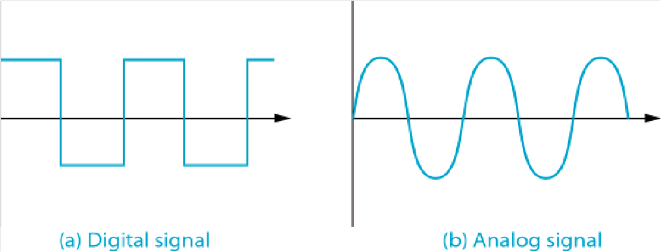
Recall: Analog & Digital Signals
first, let us recall:
analog and digital signals
digital signal encodings
Digital & Analog Signals
Link Layer B

Slide 3
Digital Encoding Schemes
There are 10 types of people;
those who know binary and those who do not.
digital data are represented by a sequence of 1s & 0s
1 refer to a high electrical voltage, and 0 refers to a low electrical voltage
two major digital encoding schemes exist:
Non-Return to Zero (NRZ) Encoding
Manchester Encoding

Slide 4
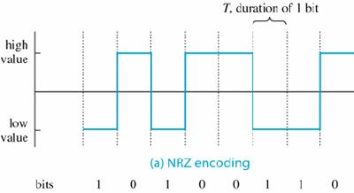
Digital Encoding Schemes (continue...)
NRZ Encoding
a 0 voltage is transmitted by raising the voltage level high, while 1 is transmitted by using a low voltage
NRZ Encoding

Slide 5
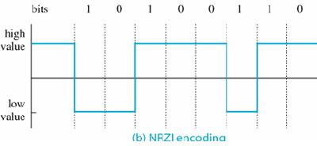
Digital Encoding Schemes (continue...)
NRZI Encoding
An alternative to NRZ is NRZI (Inverted)
The voltage changes only when a 1 is to be sent
NRZI Encoding

Slide 6
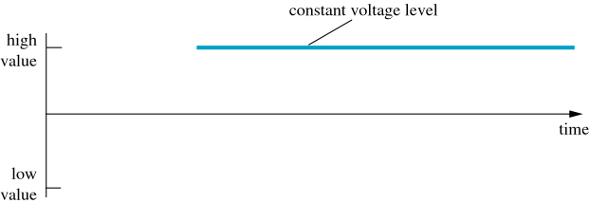
Digital Encoding Schemes (continue...)
Both NRZ and NRZI have problems; for example what is the exact sequence being transmitted in the sequence below?
Is time synchronization possible?
NRZ Encoding of a Sequence of 0s

Slide 7
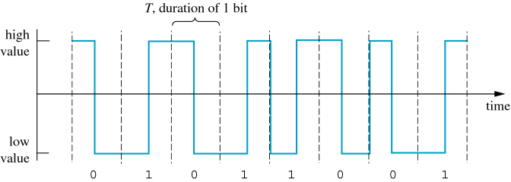
Digital Encoding Schemes (continue...)
Manchester Encoding
also called Self-Synchronizing Code
uses signal changes to keep the sending and receiving devices synchronized
0 is represented by a change from high to low in the middle of transmission and 1 is represented by a low to high change in the middle of transmission
are there any disadvantages?
Manchester Encoding

Slide 8
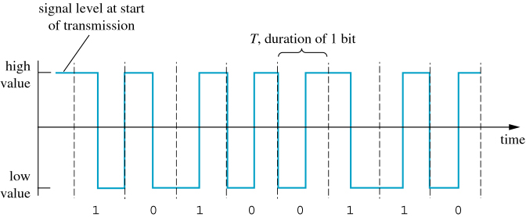
Digital Encoding Schemes (continue...)
Differential Manchester Encoding
similar to Manchester encoding, the signal will change in the middle, however
1 causes the signal to remain the same, while 0 causes the signal to change
Differential Manchester Encoding

Slide 9
Local Area Networks (LANs)
Local Area Network (LAN) covers limited geographic area, e.g. 1 or 2 buildings
in contrast, a Wide Area Network (WAN) covers large area from cities, states, countries to the entire world
LAN protocols & cabling are different than those of WAN
Stations, or nodes, are typically PCs, printers, file servers,..
LAN topologies are:
bus,
ring,
star,
fully connected

Slide 10
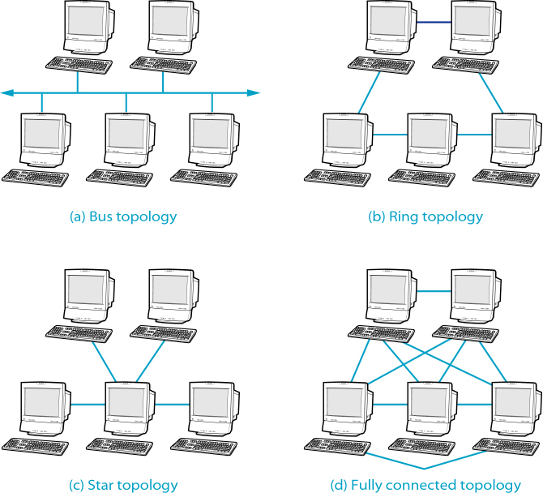
Local Area Networks (LANs)
LAN Topologies

Slide 11
Local Area Networks (LANs)
Bus Topology
the medium, referred to as a segment, is a single communication line, typically a coaxial cable or optical fiber
devices uses a contention protocol to send over the segment
only one device can send at a time for collision not to occur

Slide 12
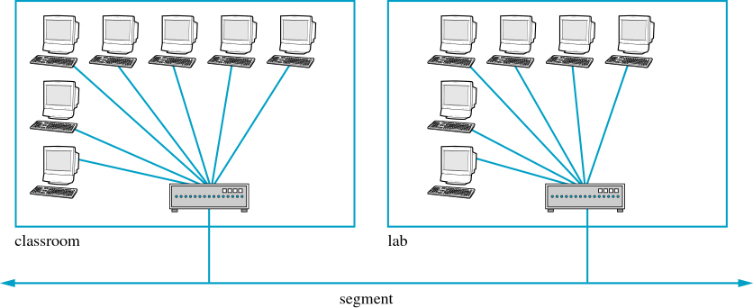
Local Area Networks (LANs)
Bus Topology
Bus Topology Connecting Multiple Locations

Slide 13
Local Area Networks (LANs)
Ring Topology
devices are arranged into a ring, where each device is connected directly to its two neighbors
for two devices to communicate, frames must be passed through all the devices in between
a ring can be unidirectional or bidirectional

Slide 14
Local Area Networks (LANs)
Star Topology
a central devices is connected to all other devices
communication must go through that central device
Fully Connected Topology
a direct connection is there between any two devices
this topology is rarely used as the general topology of a network; however it may still be utilized for a part of a network (i.e. as in data centers), which will be discussed shortly

Slide 15
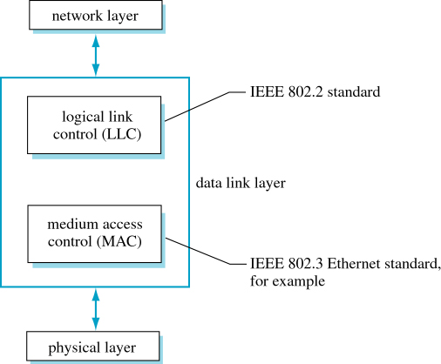
Data Link Control
Where LAN standers fit in a layered protocol?
Data Link Refinement

Slide 16
Data Link Control
IEEE 802.3 Ethernet & IEEE 802.5 Token Ring standards are MAC protocols
many different data link protocols can sit above the MAC
all of these protocols however have a common ancestor, the Synchronous Data Link Control (SDLC) protocol
SDLC was designed by IBM in the early 1970s
SDLC was designed as a bit-oriented protocol
prior to SDLC, protocols were byte oriented; that is frames are interpreted as sequence of bytes

Slide 17
Data Link Control
IBM submitted SDLC to ISO for approval, however
→ ISO created their own standard out of it, which is called High-level Data Link Control (HDLC)
IBM also submitted SDLC to ANSI for acceptance, however
→ ANSI modified and renamed it Advanced Data Communication Control Procedure (ADCCP)
ITU adopted and modified SDLC to Link Access Protocol (LAP) and later to LAPB; B for Balanced
IEEE has then created the Logical Link Control (LLC) protocol, for LANs, out of HDLC
LLC also allows LANs to connect to other LANs and WANs

Slide 18

Mac Layer
DHLC and similar protocols describes how devices can exchange frames, independent of the medium
MAC layer techniques consider the physical medium
three formal standards were defined by IEEE:
IEEE standard 802.3 – The Ethernet
proposed by Xerox, Intel & DEC
IEEE standard 802.4 – Token Bus
proposed by General Motors
IEEE standard 802.5 – Token Ring
proposed by IBM

Slide 19
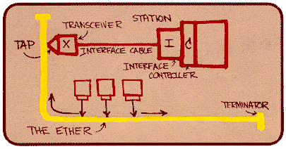
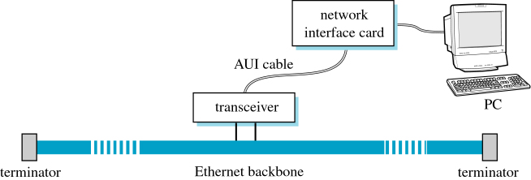
Ethernet
designed as a bus topology with some form of CSMA/CD contention protocol
today, it is considered as the dominant LAN standard
Metcalfe’s Ethernet sketch
Possible Ethernet Connection

Slide 20
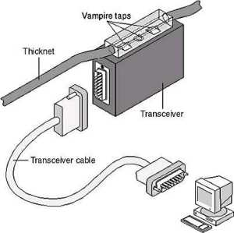
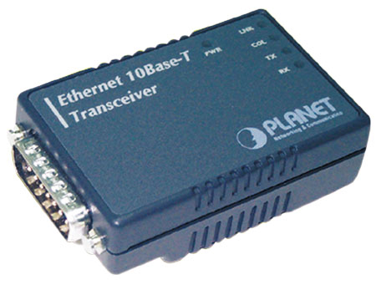
Ethernet
the transceiver’s primary purpose is to create an interface between the computer and the cable
one of its main functions is to transmit bits onto the cable using CSMA/CD contention
the connection to the network interface card is through a transceiver cable; sometimes referred to as Attachment Unit Interface (AUI) cable
can communicate with several devices through a multiplexer
Ethernet Transceiver

Slide 21
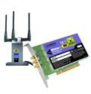
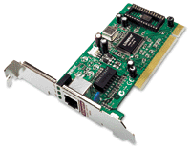
Ethernet
the network interface card (NIC) contains the logic necessary to buffer data and move it between the transceiver and the computer’s memory
it also recognizes frames on the LAN that is destined for its computer
Network Interface Cards

Slide 22
Ethernet
activities of sending from one machine to another:
➔ At the sending end:
put packet into memory and signal NIC through internal bus
NIC creates correct frame format & stores packet into data field
NIC waits for a transceiver signal that the segment is clear
once this signal is received, NIC send the frame to the transceiver, which forwards it, as bits, onto the cable then listens for collision
if no collision, transceiver informs NIC
if collision occurs, NIC uses binary exponential backoff algorithm to determine when it should try again
if number of retry attempts is exhausted, NIC signals network software, which in turn signals the error to the user

Slide 23
Ethernet
activities of sending from one machine to another (continue…):
At the receiving end:
transceiver monitors cable traffic, gets the frames and route them to NIC
NIC performs CRC error check and if the frame is error free, then check the destination address
if the destination address matches the machine of that NIC, then NIC extracts the packet from the frame, buffer it and sends an interrupt to the CPU
the machine executes network software and determines whether the packet should be accepted according to the used flow control algorithm
if all okay, the computer receives the packet; otherwise the network software responds according to the protocol at the next higher layer

Slide 24
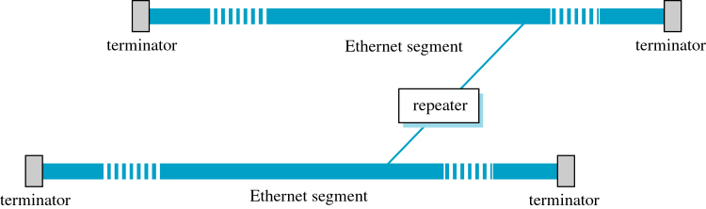
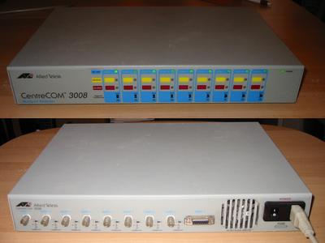
Ethernet
Repeaters
since signals degrade over distance, the original standard set the maximum length of the segment to 500 meters
in many situations, this limit is smaller than the distance needed
this problem was resolved by allowing multiple segments to be connected through repeaters
a repeater receives the signal, regenerates and retransmits it
the standard states that the maximum number of repeaters between any two devices is 4
Connecting Two Segments
Repeater

Slide 25
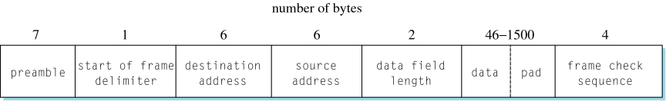
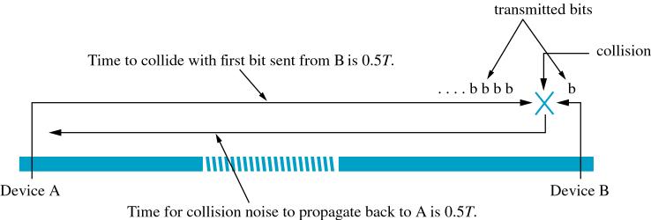
Ethernet
Frame Format
Ethernet Frame Format
Maximum Time to Detect a Collision

Slide 26
Ethernet
What is the lower bound of data bytes?
maximum segment size with maximum repeaters: 500 * (4 + 1) = 2500 m
signals travel on a copper wire with a speed of about 200 m / µsec
it takes about 12.5 µsec to travel from one end to another
total time to travel and come back is 25 µsec
considering the different delays due to collision and repeaters processing for both the signal and the noise, worst case was set as double that time, which is 50 µsec
each frame must take at least 50 µsec to send
at 10Mbps (10 bits/µsec) rate, the device needs to send 500 bits in 50 µsec
the was rounded, for safety, to 512 bits or 64 bytes
finally, the data lower bound was set to 46 bytes to make sure that the frame will be large enough for CSMA/CD to work correctly

Slide 27
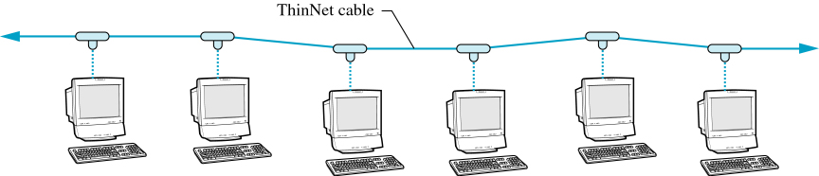
Ethernet
ThickNet, ThinNet & Hubs
original implementation of the Ethernet used 10Base5 cable (a wide cable of 10 mm diameter); this was referred to as ThickNet
ThickNet had the advantage of allowing one segment to be up to 500 m
however, the size of the wire represented a major disadvantage
alternatively, transceiver logics were placed on NIC, and 10Base2 (a much thinner wire, referred to as ThinNet) replaced 10Base5 wire
ThinNet however has a higher resistance and so it allows a maximum segment size of 185 m
ThinNet Connections Using T-Connector

Slide 28
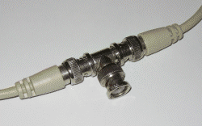
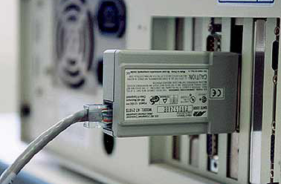
Ethernet
ThickNet, ThinNet & Hubs
10Base2 T-Connector
Possible Transceiver Settings

Slide 29
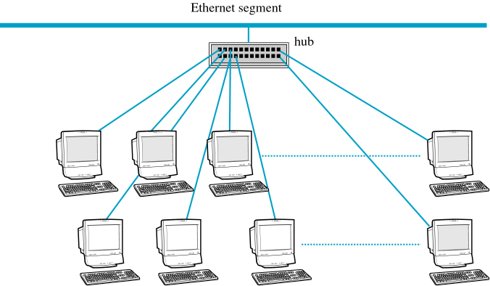
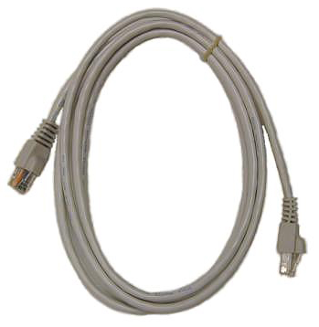
Ethernet
ThickNet, ThinNet & Hubs
a Hub, sometimes referred to as multiport repeaters, is a device with many ports; each connects to a device using 10BaseT cable
a hub can also be connected to another hub
with that, Ethernet has no longer a physical bus topology; so how does this affect the NICs, CSMA/CD mechanism, …etc.?
10BaseT Cable
Connecting PCs with a Hub

Slide 30
Fast Ethernet (100Mbps)
IEEE 802.3u
no change in the MAC layer details from 10Mbps Ethernet
10Basex runs mainly over coaxial cables
100Basex however runs over optical fibers, UTP or STP and uses star topology
some of the fast Ethernet standards are:
100BaseTX
100BaseT4
100BaseFX

Slide 31
Fast Ethernet (100Mbps)
100BaseTX
designed to run over category 5 UTP
10Basex used Manchester coding
using same Manchester coding but with a higher frequency would result in higher rate
the higher frequency however over UTP produced a lot of interference
using NRZI was an option that was finally ruled out due to its synchronization problems
instead, 100BaseTX used 4B/5B Encoding

Slide 32
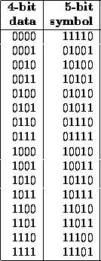
Fast Ethernet (100Mbps)
4B/5B encoding replaces every ½ byte (4 bits) with 5 bits
A string such as: 1010-0010-0000-0000-0000-0000 is hence replaced by: 10110-10100-11110-11110-11110-11110
What is the advantage of that 4B to 5B transformation?
Coding Using 4B/5B

Slide 33
Fast Ethernet (100Mbps)
with 4B/5B, it was possible to use NRZI instead of Manchester
however NRZI still produced noise over UTP even with lower-frequency signal
to reduce the signal, a new signaling scheme, called Multilevel Line Transmission-Three Levels (MLT-3), was used
MLT-3 defines 3 state signals: -1, 0 & +1
if bit is 0 → MLT-3 remains at current state
if bit is 1 → MLT-3 moves to the next state

Slide 34
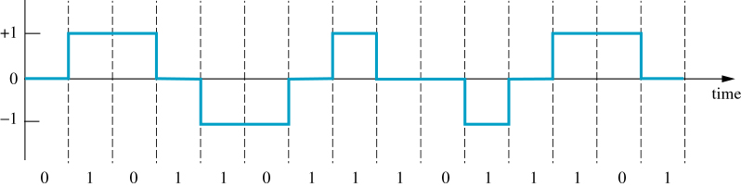
Fast Ethernet (100Mbps)
How good is MLT-3 compared to Manchester coding?
Multilevel Line Transmission–Tree Levels (MLT-3)

Slide 35
Fast Ethernet (100Mbps)
100BaseFX
designed to run over optical fiber
100BaseTX, using UTP, has a maximum length of 100 meter
100BaseFX has a maximum length of 2 KM
still uses 4B/5B
NRZI is used instead of MLT-3 since optical fiber does not have the frequency constraint of UTP

Slide 36
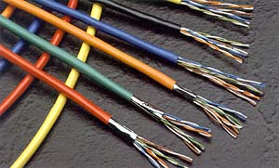
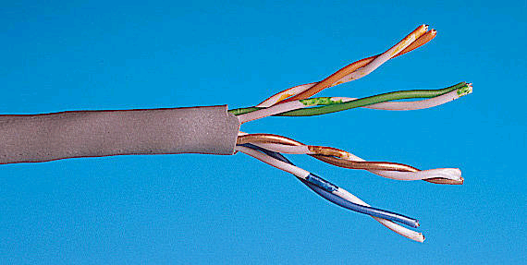
F ast Ethernet (100Mbps)
100BaseT4
designed to run over category 3 UTP (voice-grade wire)
Category 3 UTP
Category 5 UTP

Slide 37
Fast Ethernet (100Mbps)
100BaseT4
the utilization of cat 3 UTP facilitated upgrades from 10Basex to Fast Ethernet without requiring new wiring
however, cat 3 UTP is even more susceptible to noise than cat 5 UTP
to overcome the problem, 100BaseT4 continue to use MLT-3 encoding but over 8B/6T encoding scheme (rather than 4B/5B)

Slide 38
Fast Ethernet (100Mbps)
100BaseT4
8B/6T associates each byte (8 bits) with a unique string of 6 ternary values, called trits
8 bits → 2⁸ = 256 possible strings
6 trits → 3⁶ = 729 possible trits
each of the 256 strings can then be associated with a unique trit
a trit is then represented by a signal of a +, 0 & - combination

Slide 39
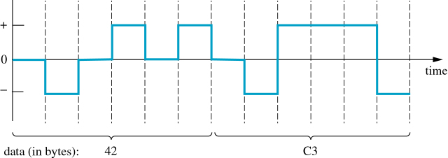
Fast Ethernet (100Mbps)
100BaseT4
Data (Hex) (Binary) 8B/6T Code
00 0000 0000 +-00+-
01 0000 0001 0+-+-0
..................
0E 0000 1110 -+0-0+
..................
FE 1111 1110 -+0+00
FF 1111 1111 +0-+00
Partial 8B/6T Encoding Table
8B/6T Encoding

Slide 40
Fast Ethernet (100Mbps)
100BaseT4
with 8B/6T, 8 bits are transmitted using 6 intervals
although this is a frequency reduction of 25%, this is not enough to send without noise of cat 3 UTP
to allow 100Mbps, 3 of the 4 UTP pairs are used for parallel transmission while the last one is used to sense collision
each of the wires carries less trits (less frequency), so cat 3 UTP can handle
using three pairs to send allows the needed 100Mbps (actually 75 M trits/second)
the disadvantage is that 100BaseT4 can not operate in full-duplex mode

Slide 41
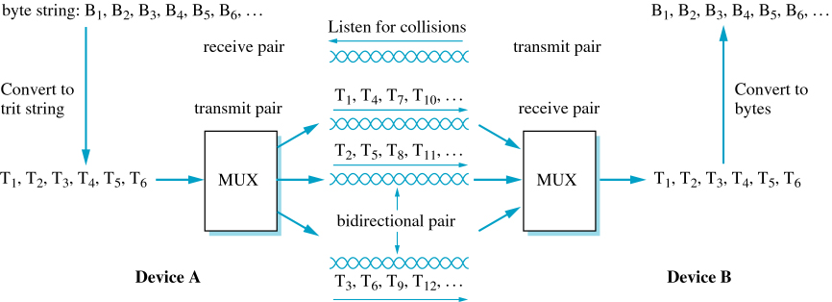
Fast Ethernet (100Mbps)
100BaseT4
Sending Data on 100BaseT4 over Four Wire Pairs

Slide 42
Gigabit Ethernet
1000 Mbps rate
designed to run over both fiber optics and copper
supports both full-duplex and half-duplex
1000BaseSX & 1000BaseLX run over optical fiber
1000BaseT & 1000BaseCX run over copper wires
in 2002, 10 Gigabit Ethernet was developed by IEEE802.3ae task force

Slide 43
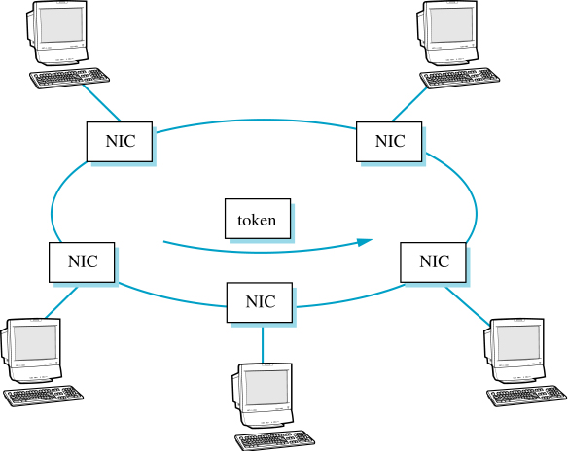
Token Ring
IEEE standard 802.5
Token Ring Network & Circulating Token

Slide 44
Token Ring
uses Differential Manchester encoding
date rates are listed at 1Mbps & 4 Mbps (although IBM token rings support 4, 16 & 100 Mbps rates)
issues:
how frames are transmitted
how rings are claimed and released
what happen if a device fails
how tokens and data frames can be distinguished

Slide 45
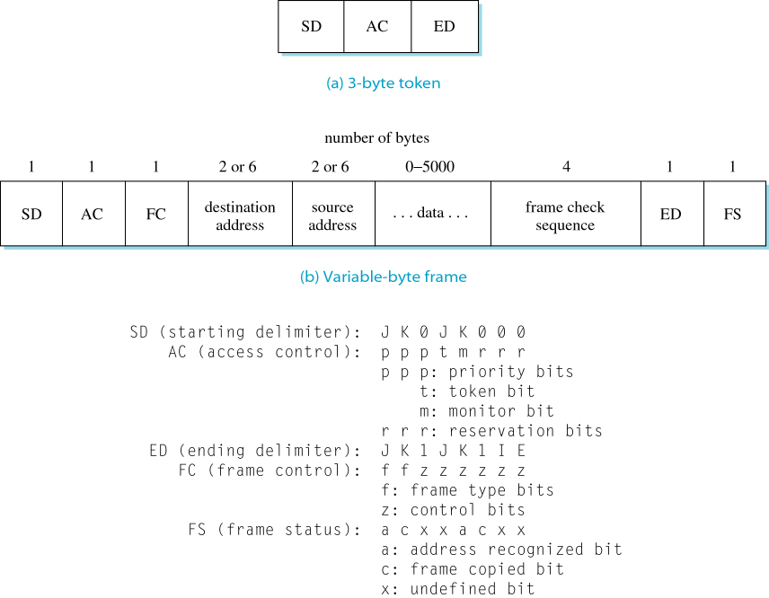
Token Ring
Token & Frame Formats
Token and Frame Formats

Slide 46
Token Ring
Reserving & Claiming Tokens
token can be passed from the one that just used it to its neighbor
this scheme has its advantages and disadvantages
each device is assigned an internal priority
the token is also assigned a priority level; a device can claim the token if its priority is greater than the token priority level
initially, the token priority is set to 0. The priority then changes by the reservation system, which is responsible for reserving tokens and assigning priorities

Slide 47
Token Ring
Ring Maintenance
token problems are possible, for example,
Token may be damaged due to noise
Token may be lost if the device that has it crashes
one of the devices is defined as a monitor station
some of the problems, such as detection of an orphan frame or detection of a lost token, can be handled by the monitor station
some other problems cannot be handled by the monitor station, such as a break in the ring or if the device that malfunctioning is the monitor itself
these problems are handled using control frames

Slide 48
Token Ring
Ring Maintenance
the FC byte defines the frame’s function
0001 Express buffer
0010 Beacon
0011 Claim token
0100 Ring purge
0101 Active monitor present
0110 Standby monitor present
Token Ring Control Frames

Slide 49
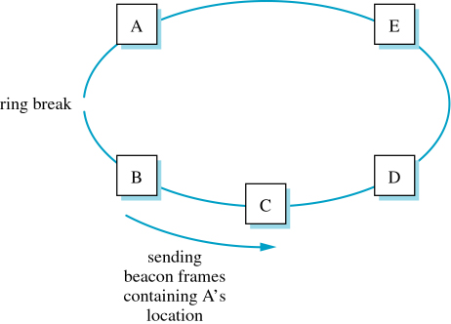
Token Ring
Ring Maintenance
Locating a Ring Break

Slide 50
MAC addresses
32-bit IP address:
network-layer address for interface
used for layer 3 (network layer) forwarding
MAC (or LAN or physical or Ethernet) address:
function: used ‘locally” to get frame from one interface to another physically-connected interface (same network, in IP-addressing sense)
48 bit MAC address (for most LANs) burned in NIC ROM, also sometimes software settable
e.g.: 1A-2F-BB-76-09-AD
hexadecimal (base 16) notation
(each “number” represents 4 bits)
Link Layer

Slide 51
IP Routing
a device connected to an Ethernet would sense an Ethernet address on the segment to know which packet is destined for it
however, this Ethernet address is a 48-bit address that has no significance on a global IP scale
so, how can the device then recognize a packet containing an IP address?

Slide 52
IP Routing
how the router determines the physical address from the IP address when the packet is embedded into a LAN frame
when the router receives an IP packet, there are two possibilities:
The packet’s destination machine is in a network where the router is attached, or
It is not
if the destination machine belongs to the same network, then the router can directly send the packet to the destination; that is called Direct Routing
the router will know that since the network part of the IP address is the same as its own network part

Slide 53
IP Routing
but still, how can the router determine the physical address from the IP address?
one approach is the Dynamic Binding, also called Address Resolution Protocol
the router transmits a broadcast request to all devices in the LAN, specifying the IP address
the device with the specified IP responds with its physical address
the router can then sends the packet to the proper device; it also stores this information on a local cache for future requests

Slide 54
IP Routing
what if the destination is not directly reachable through one of the router’s networks?
the router then uses hierarchical routing, as discussed in previous lectures, to determine another router to send the packet to
the packet will then travel from one router to another until it reaches a router connected through the same network to the destination machine

Slide 55
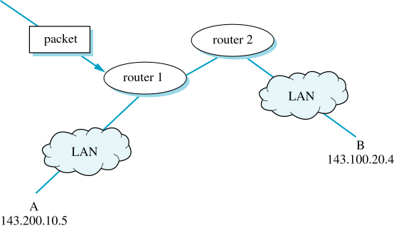
IP Routing
Example
IP Routing

